Slide 1


PROJECT 3
ZOMATO SALES ANALYSIS
Excel, Tableau, Power BI, SQL
GROUP – 2
Anandhu A S
Kavya R
Madhuri Bonthu
Rakesha T M
Sameer Akhtar
Somu Shanthi Sri
Suhasnee Gupta
Surasura Raju

Slide 2

This project show cases our end-to-end data analysis skills using Excel, SQL, Power BI, and Tableau. We worked with multiple datasets—covering meeting records, invoices, brokerage data, fees, and individual budgets.
The goal was to extract insights, track performance metrics, and create interactive dashboards to support decision-making. Each tool played a unique role in the data journey—from cleaning and transformation to visualization and storytelling.
INTRODUCTION

Slide 3
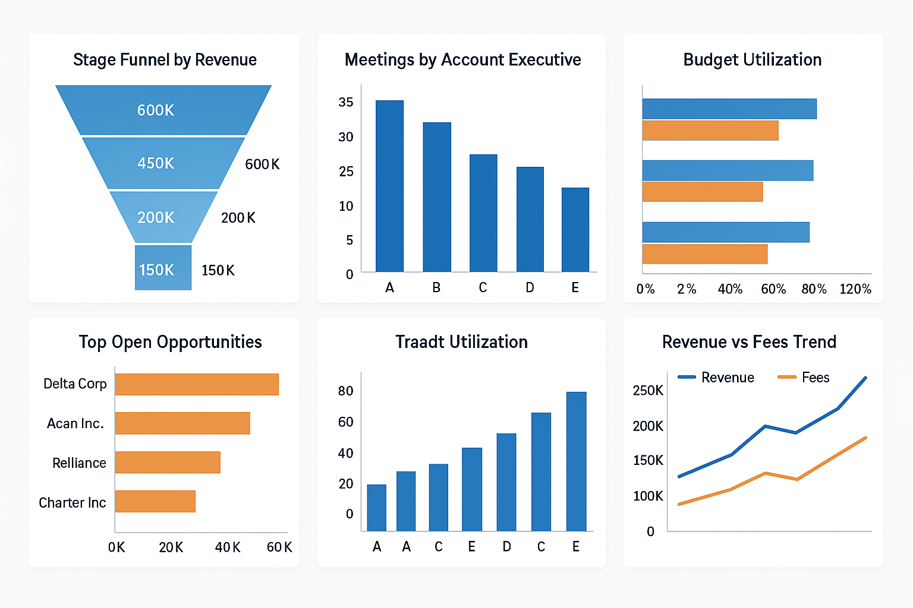
OBJECTIVES
To clean and combine multiple datasets from different sources.
To analyze key performance indicators (KPIs) such as revenue, meeting counts, and budget utilization.
To create dashboards for visualizing trends and performance.
To deliver actionable insights and recommendations for better business decisions.

Slide 4

DATA CLEANING PROCESS
Removed duplicates, null values, and irrelevant fields.
Standardized formats (dates, categories, numerical values).
Handled missing values with appropriate imputation.
Verified data consistency across datasets.
Ensured clean, structured data for analysis.

Slide 5

DATA OVERVIEW
Using Excel, We began by cleaning and organizing the data. Power Query and Power Pivot helped to merge the datasets and create Data Models.
SQL was used for querying structure data and performing joins, aggregations, and filtering.
The refined data was visualized in Power BI and Tableau.

Slide 6
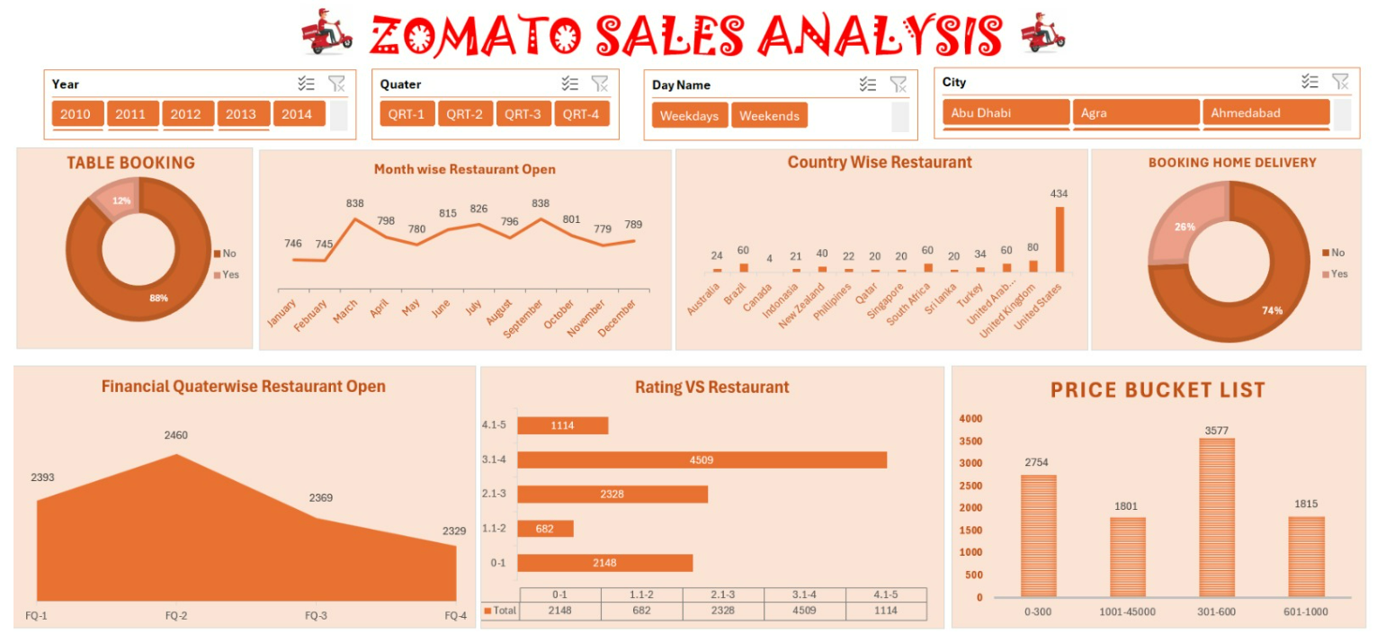
Excel Zomato Sales Analysis Dashboard Preview

Slide 7
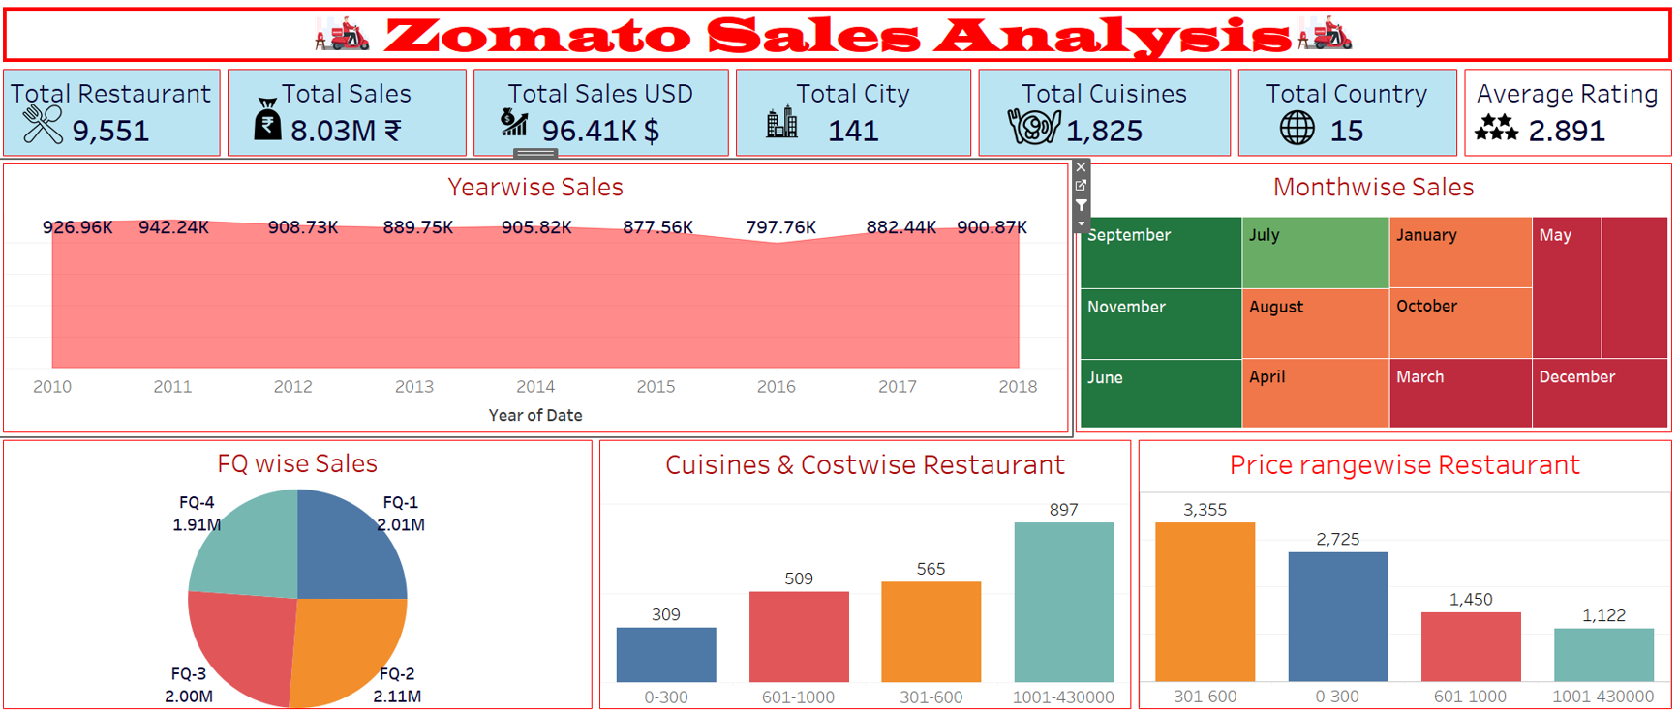
Tableau Zomato Sales Analysis Dashboard Preview

Slide 8
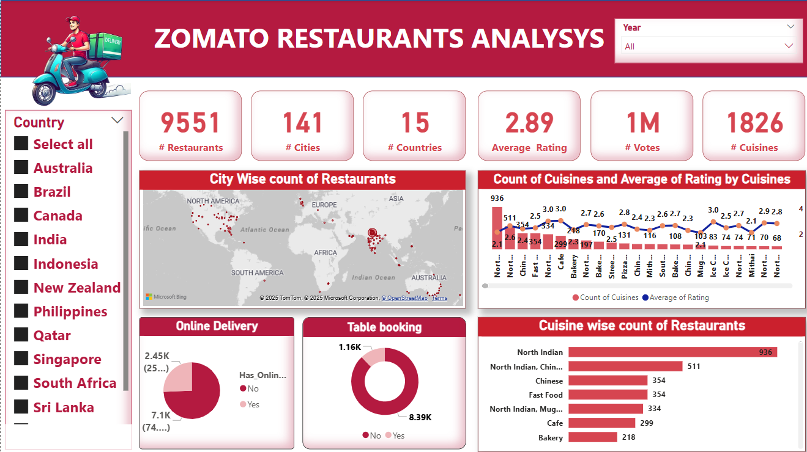
Power BI Zomato Sales Analysis Dashboard Preview

Slide 9
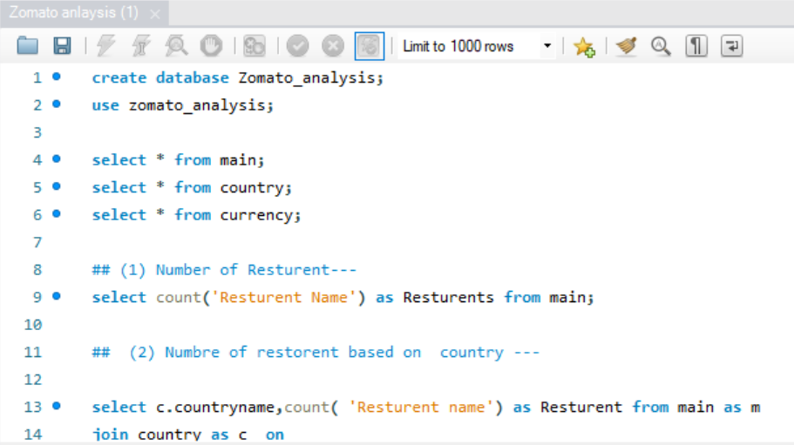
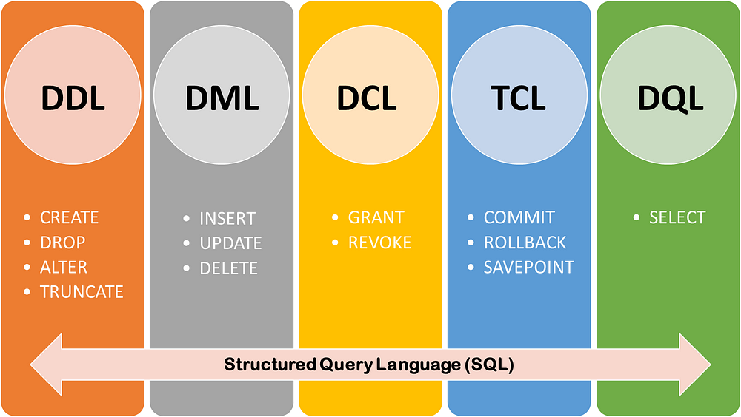
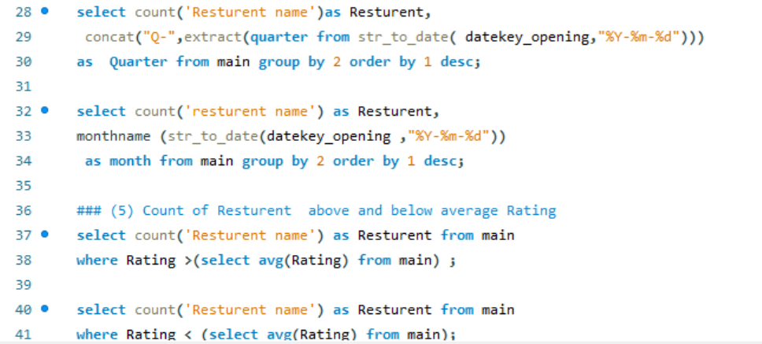
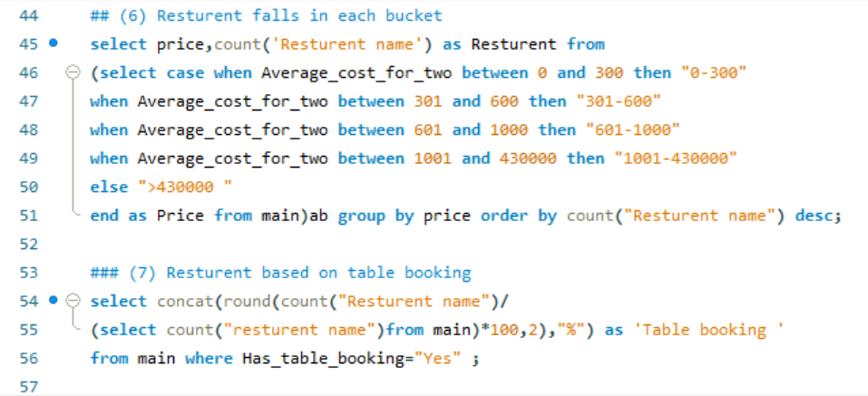
SQL Zomato Sales Analysis Commands Preview

Slide 10
Strategic Insights
- Optimize Inside Sales and Website channels for further growth
1
- Improve conversion rates by reducing Closed Lost numbers
2
- Leverage successful industry segments (Safety & Life Sciences)
3
- Consider diversifying or improving underperforming lead sources
4

Slide 11

Challenges Likely Faced
In EXCEL → Data Cleaning, Pivot Table Management, Sheet Linking, Visualization, Managing large datasets.
In POWER BI→ Inconsistent data formats and missing entries.
Complex table relationships and cardinality issues.
Writing and debugging complex DAX expressions.
In SQL→ Data normalization and ensuring correct primary-foreign key relationships.
Missing values and nulls in Expected Amount, Converted, etc.
Performance bottlenecks in aggregate-heavy queries.
In Tableau→ Managing sheet layouts inside Tableau containers.
Creating accurate calculated fields and filters.
Integration of data from multiple sources (INR, USD, ratings, etc.)

Slide 12


Gained valuable business insights from data analysis.
Overcome data loading challenges using local data from different data source file in MySQL.
Tableau helped visually explore with interactivity.
Functions like LOD, calculated fields, and filters were key to insights.
Provided actionable recommendations for improvement.
Focus on growth and efficiency moving forward.

Slide 13


